Slide 1


RNS Institute Of Technology
Bengaluru-560085
Department Of Information Science
Database Management System(DBMS) Mini Project
Blood Bank Management System
By
T . Kishore
USN:1RN17IS103
5 ‘B’
Tilakraj Singh Rao
USN:1RN17IS109
5 ‘B’
Under The guidance Of :
LAB INCHARGE :
Mrs. Kusuma . R
Assistant Professor
FACULTY INCHARGE :
CSR
Assistant Professor
Department Of ISE , RNSIT

Slide 2
Contents
Abstract
Introduction
Front end and Back end tools
ER-Diagram
ER to Schema Mapping
Schema Diagram
Tables description with Normalization
Stored Procedures and Triggers
Results
Snapshots
Applications
Conclusion
References

Slide 3
Abstract
A bloodbank database management system is a normal application to represent the database management activities . Used to store the information and display the information of all the respective entities.
This is a management activity

Slide 4
Introduction
A blood-bank database management system is an application of database management system representing the normal database actions .
The various actions that take place in this system are:
Creation of login or sign-up entries :
Hospital /Blood-Bank : Any recent or previous organizations are allowed to register or create their accounts for any future actions .
Donor : A donor is automatically created an account by the organization at which he donated.
Creation of various table entries as follows
Donors : A hospital is allowed to enter the details of all their donors and the recipients based on their date of action.
Recipients: A Hospital is allowed to enter the details of all their recipients which are inserted into their tables.
Blood: A hospital or a private blood bank have an option of entering the data of all the blood groups received by the donors based on the actions taking place.
Manager: A manager is held responsible for all the actions taking place in the actions.

Slide 5
Actions that the following organizations can take:
Hospital :
View their donors and recipients ,
View all the managers of any organization in their city .
Update the details of any respective blood group.
Update the details of manager .
View the blood-banks or hospitals in their city in case of any requirement of a specific group of blood.
Blood-Bank :
View their donors .
View all the managers of any organization in their city .
Update the details of any respective blood group.
Update the details of manager .
View details of any hospitals in city which is in shortage of a specific blood-group.
Donor :
View the personal details of all his previous activities .
And also his previous health details .

Slide 6
Front End & Back End Tools
Front-End
Java , JavaFX with Scene Builder and CSS for the front-end part .
Back-End
Java for the connection and all the DML,DDL statements with respect to the database .
SQL and phpMyAdmin for the database creation .

Slide 7
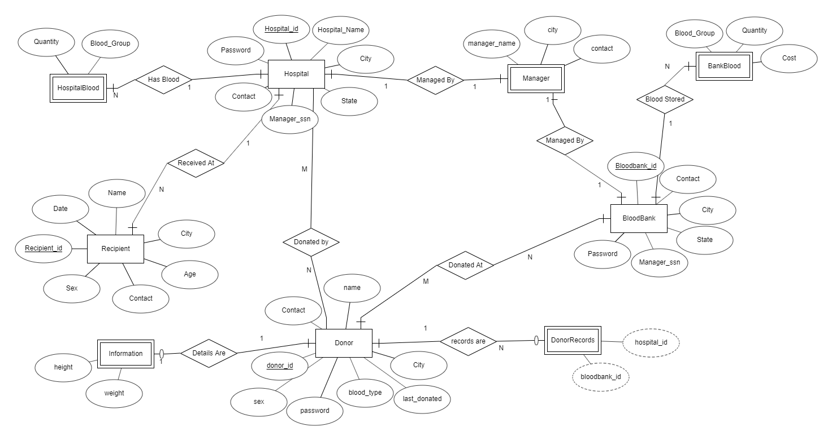
ER Diagram

Slide 8
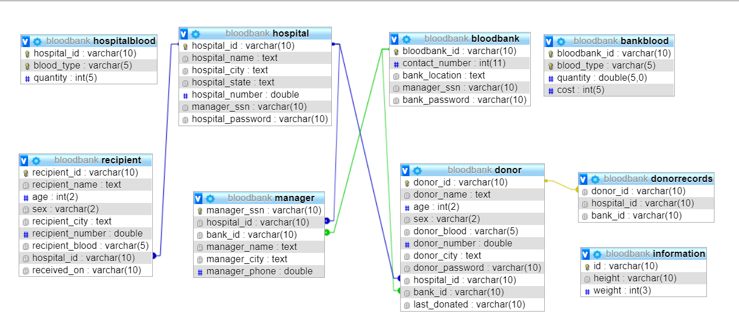
Relational Schema

Slide 9
Schema
Hospital ( hospital_id , name , city , state , password , contact , managerssn)
Bloodbank ( bloodbank_id , city , state , contact , password , managerssn)
Donor ( donor_id , name, city, password, age, sex, blood_group, contact, hospital_id, bloodbank_id)
Recipient ( recipient_id , name , city , age , sex , blood_group , contact , hospital_id , date)
Information ( donor_id , height , weight)
Donorrecords ( donor_id , hospital_id , bloodbank_id )
Manager ( manager_ssn , name , city , contact , hospital_id , bloodbank_id )
HospitalBlood ( hospital_id , blood_type , quantity )
BankBlood ( bloodbank_id , blood_type , quantity , cost )

Slide 10
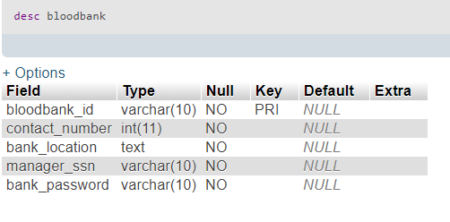
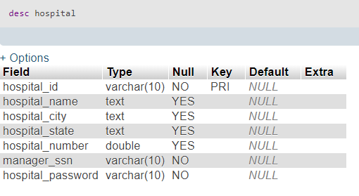
Table Description
There are several tables created under a database named bloodbank .
And the description of the table under the named database are as follows.
1:Hospital
2:BloodBank

Slide 11
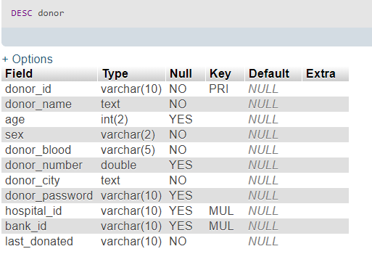
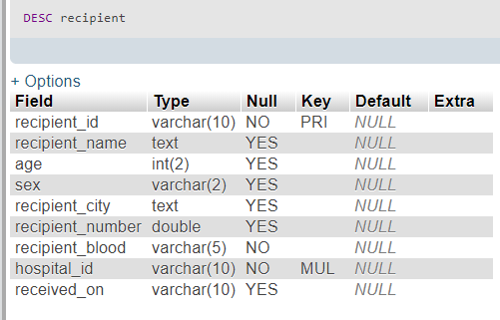
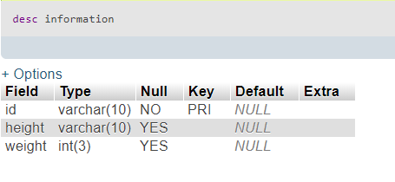
3:Donor
4:Recipient
5:Information

Slide 12
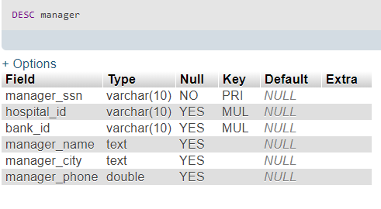
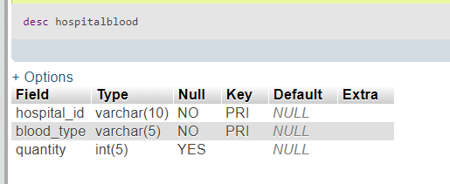
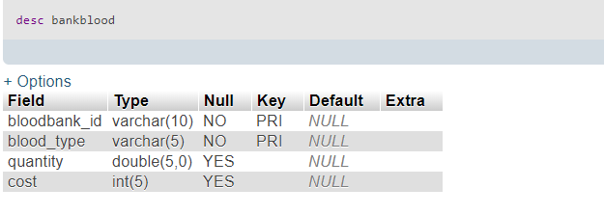
6 : Manager
7:HospitalBlood
This Table holds the details of the blood groups available in the respective hospitals .
7:BankBlood
This Table holds the details of the blood groups available in the respective hospitals blood banks

Slide 13
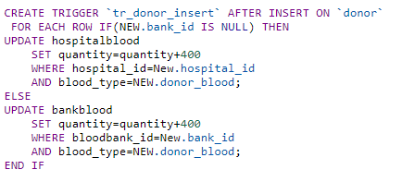
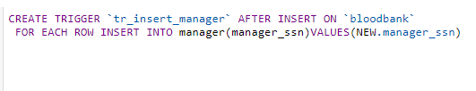
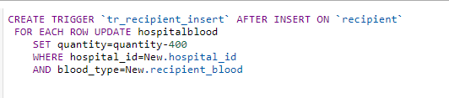
Triggers
Trigger 2:
This trigger allows to create a data entry automatically for a manager for their respective blood-bank.
Only if manager_ssn is specified by the organization.
Trigger 1:
Here a trigger is directly created when an account of donor is created , the amount of blood of their respective blood group is increased by approx. 400ml as recorded by the red cross society is the amount of 1 cell or unit received from a donor .
Trigger 3:
This trigger is to automatically reduce the amount of a bllod-group in their respective organization by 400mL , believing that it is a standard amount of blood a receiver receives for a respective time .Then the admin or manager of the hospital is allowed to update the details thereafter

Slide 14

Trigger 4:
This trigger is to automatically create an entry in the manager table for a manager social security number(ssn) mentioned in the registration of the hospital.
This happens while registering.
If the manager details have to be updated , it can be done
By updating in the manager-updation page.

Slide 15
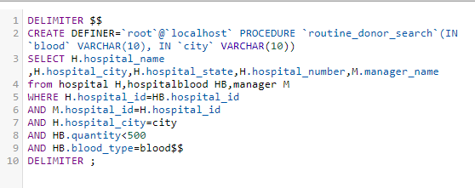
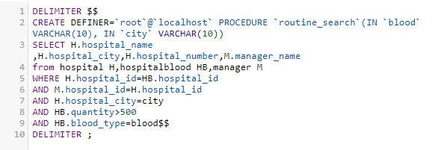
SQL Procedures
Procedure 1:
To check for hospital/blood-banks with a shortage of blood .
Procedure 2:
To check for hospital with adequate amount of a particular blood-group so that receiver might find it easy to find a hospital.

Slide 16
Results
Hence a database management system has been created for daily activities of blood transaction between :
Hospital and Donor
Hospital and Recipients
Donors and Blood-Banks
Adding to above properties , few other results are :
A procedure to check any hospitals /blood-banks with an urgency of a particular blood group
Hospitals are allowed to contact nearby managers of a particular organization.
Recipients are allowed to check for hospitals with an abundance of blood for a particular blood group.

Slide 17
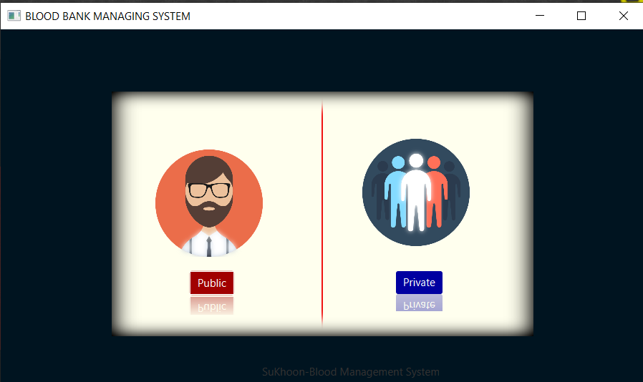
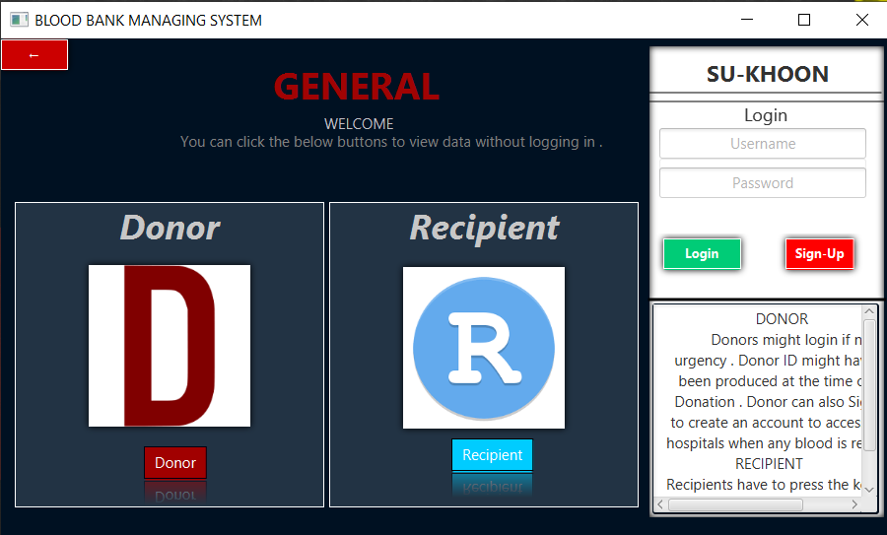
Snapshots
Home Page
Login Page

Slide 18
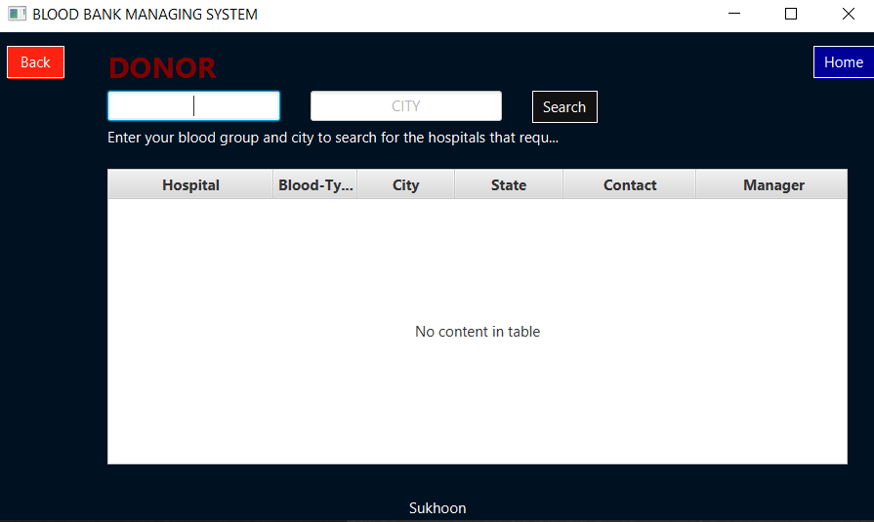
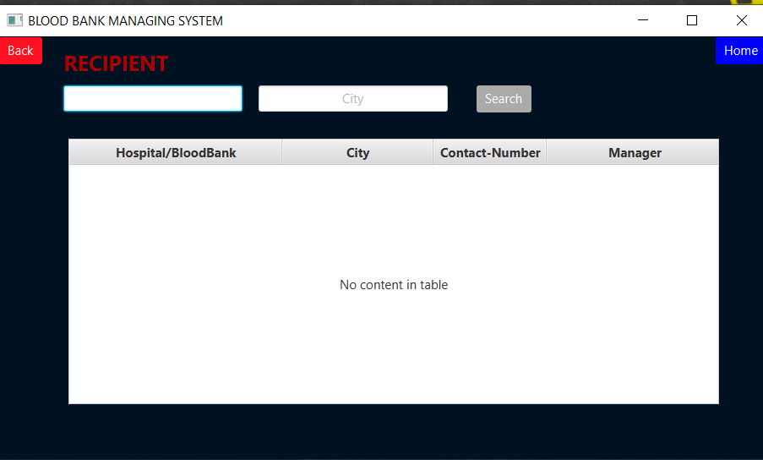
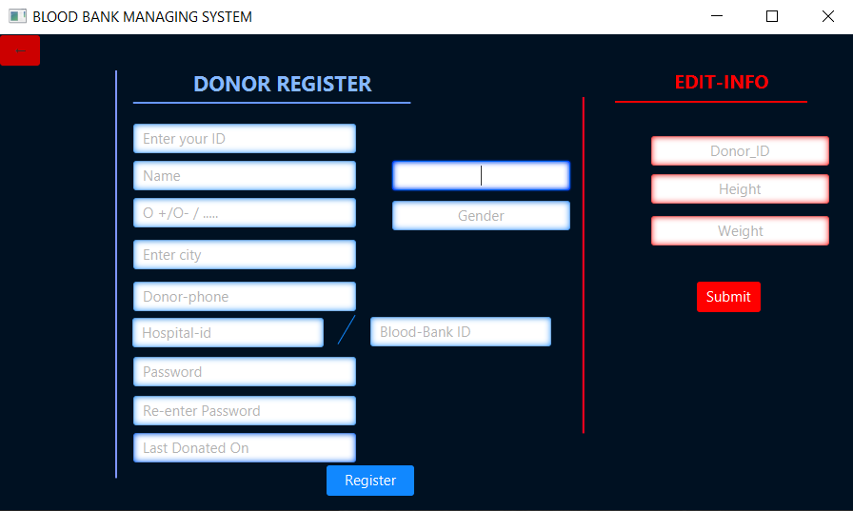
To View hospitals with an urgency of blood
To view hospitals with the blood required .
Sign-Up Page

Slide 19
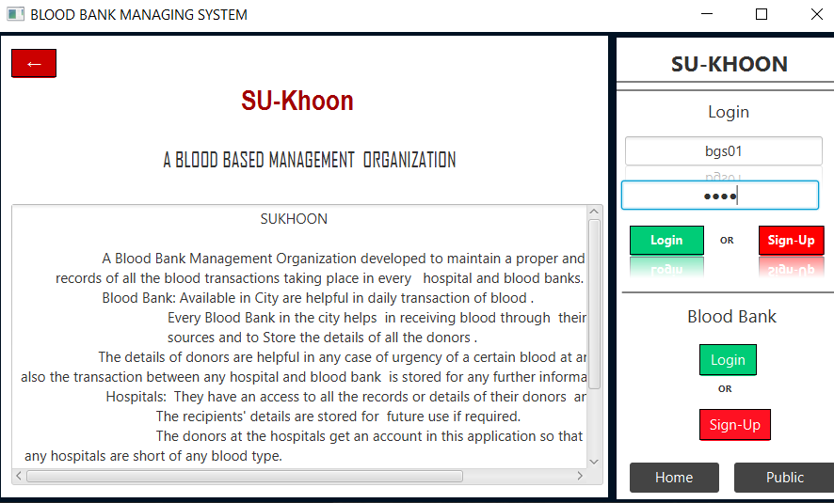
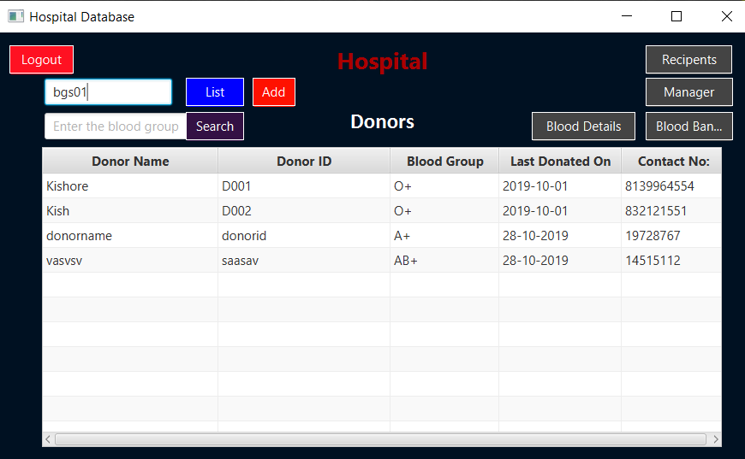
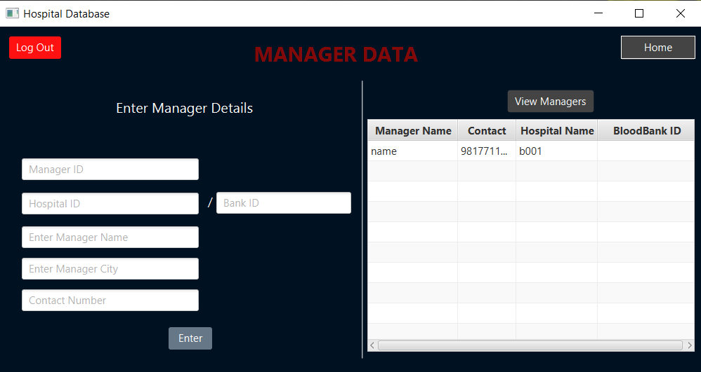
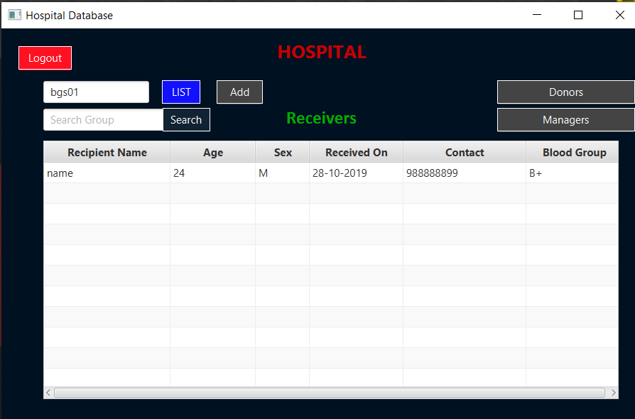
Home for organizations
Login Page
Page to view donors of the organization
Page to update and view managers of other organizations
Page to view receivers of the organization

Slide 20
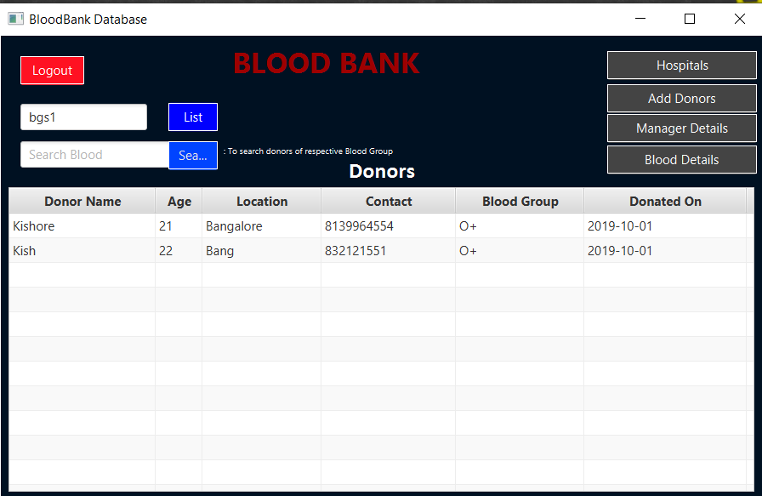
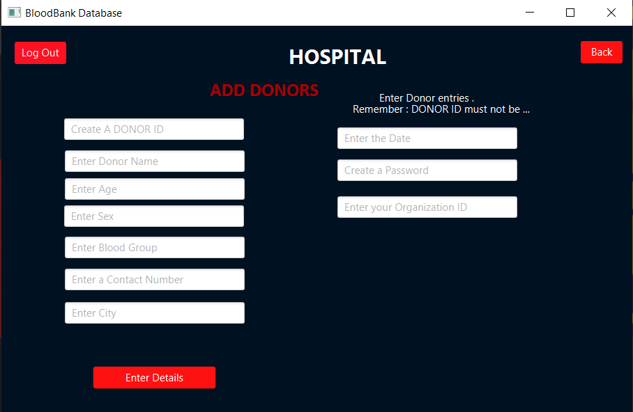
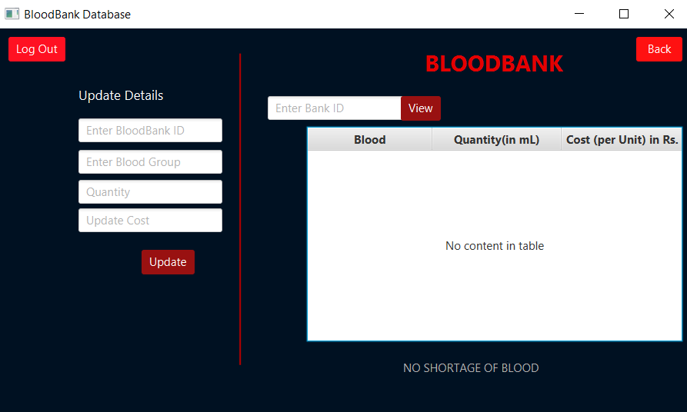
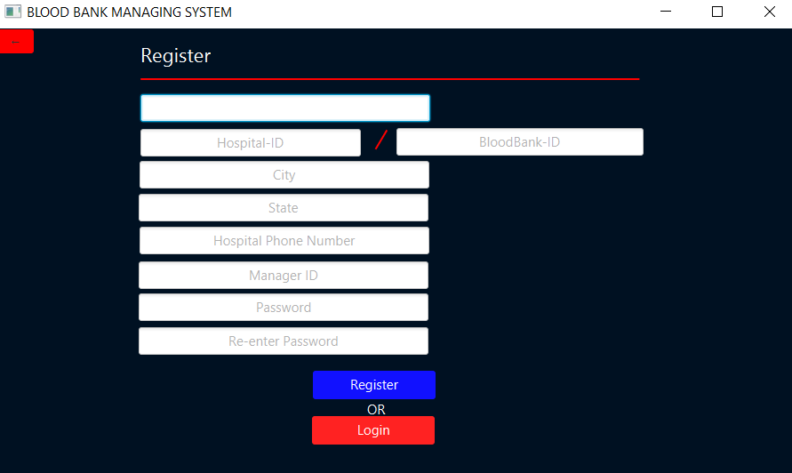
Page to view donors of the blood-bank
Page to add donors of the organization
Page to update the details of blood-group of the organization
Registration Page for hospitals/blood-banks.

Slide 21
Applications
The applications of this project are as follows :
This desktop application can be used for daily activities that takes place with the blood transfers with hospitals .
The Blood Banks are benifited in a way to transfer the blood to any hospital with shortage or urgency of a blood group .
The donors and recipients are allowed to view the hospitals with any blood type for any requirements of a patient of their own .
Donors are also allowed to view their previous actions .

Slide 22
Future Enhancements
This is a vast subject due to which there can be further updates performed.
Few of the are:
A social platform for further communication for any requirements of a specialist surgeons can be created.
Can be enhanced to develop medical conditions for few hospitals.

Slide 23
Conclusion
This project has given me an ample opportunity to design, code, test and implements an application. This has helped in putting into practice of various Software Engineering principles and Database Management concepts like maintaining integrity and consistency of data. Further, this has helped me to learn more about ORACLE 8, JAVAFX, HTML, VB Script, Adobe Photoshop 7.0 and Personal Web Server.
I thank my guide for his invaluable contribution in guiding me throughout the project. I also thank my parents and friends who have supported and motivated me to complete this project successfully.
As there was a little number of contact person’s information given, some people may face difficulty in getting blood fast. So i like to gather more information regarding the contact persons in other cities as well as villages and will provide much more services for the people and help everyone with humanity.

Slide 24
References
For the working of blood-banks in hospitals : https://www.urmc.rochester.edu/pathology-labs/blog/july-2016/lifesaving-work-of-the-blood-bank-and-transfusion.aspx
For bloodbanks related queries : https://www.betterhealth.vic.gov.au/health/conditionsandtreatments/blood-donation
For SQL, database information :
For Study of JavaFX : JavaFX Programming -By Andreas Pomoralli
For JDBC : MySQL &JDBC -By Omer Edmir Amer
And for other queries and studies , ProgrammingKnowledge , stackoverflow.com were helpful.

